Slide 1

















MaiaScript High-Performance Programming with MaiaScript and WebAssembly by Roberto Luiz Souza Monteiro
M.A.I.A.
MaiaScript
MaiaStudio
MaiaRecorder
Meet
LearningBLockly

Slide 2
Why yet another programming language?
We want to develop a meta-cognitive engine. An artificial intelligence capable of learning how to learn.
We created MaiaScript to make this task easier and more efficient.

Slide 3
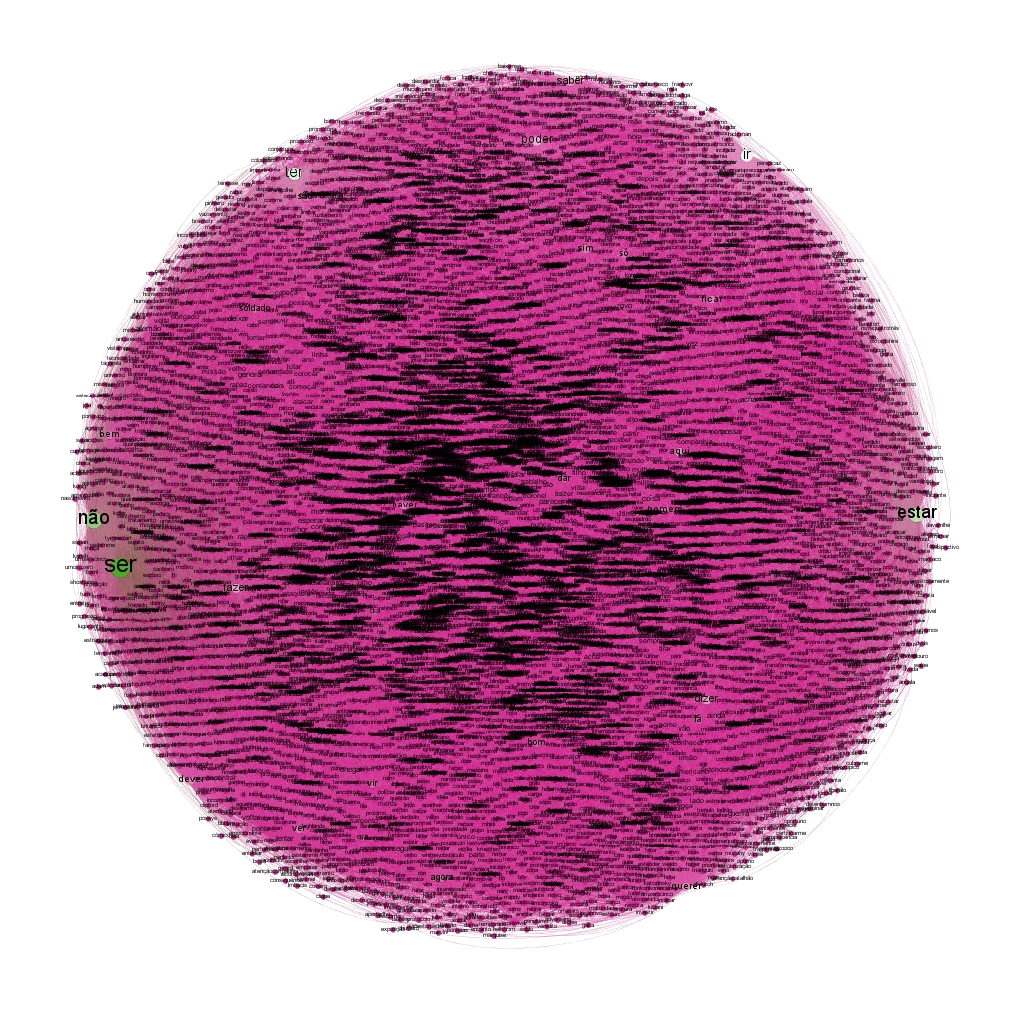
M.A.I.A. - Maia Artificial Inteligence Autogenous
First prototype:
ma-tzi-li

Slide 4
MaiaScript
Object-oriented, cross-platform, high-performance programming language.
Main libraries:
ANN;
CAS;
CNA;
Core;
DFA;
MaiaCompiler;
MaiaGPU;
MaiaString;
MaiaVM;
Mathematics;
Matrix;
SNET;
Statistics;
System;
Task.

Slide 5
MaiaStudio
IDE (Integrated Development Environment) developed to allow the construction of programs in MaiaScript on the web. The program is composed of:
MaiaEditor;
MaiaConsole;
MaiaCompiler ;
MaiaVM (MaiaScript Virtual Machine).

Slide 6

MaiaRecorder
Screen recorder for producing classes in screencast mode.
Developed to be the MaiaMeet conference recorder.

Slide 7
MaiaMeet
Videoconferencing manager developed to carry out remote work for the Maia group.
Based on Jitsi Meet and uses Jitsi Videobridge, a server program compatible with WebRTC and MaiaRecorder, a screen recorder implemented using Media Capture and Streams API technology.

Slide 8
LearningBlockly
LearningBlockly is a block-based programming learning environment.
Built to teach programming in MaiaScript.

Slide 9
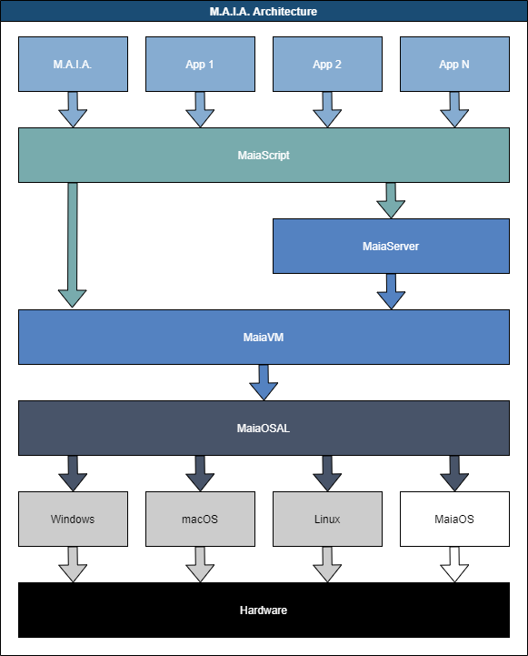
MaiaScript architecture.
Applications
Programming language
Application server
Virtual machine
Hardware abstraction
Operating system (OS)
Hardware independence

Slide 10

Cronograma
2020
2021
2022
MaiaScript
MaiaRecorder
MaiaServer
MaiaStudio
MaiaMeet
M.A.I.A.
LearningBlocly
MaiaHPC
CNATool
Lyza (MaiaRobot)

